Slide 1
Force 2020 Facies Classification
Nilesh Singhal

Slide 2
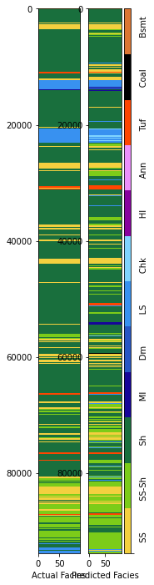
Problem Statement
The objective of the competition is to create machine learning model to correctly predict lithology labels using provided well logs, provided NPD Lithostratigraphy and well location X,Y position.

Slide 3
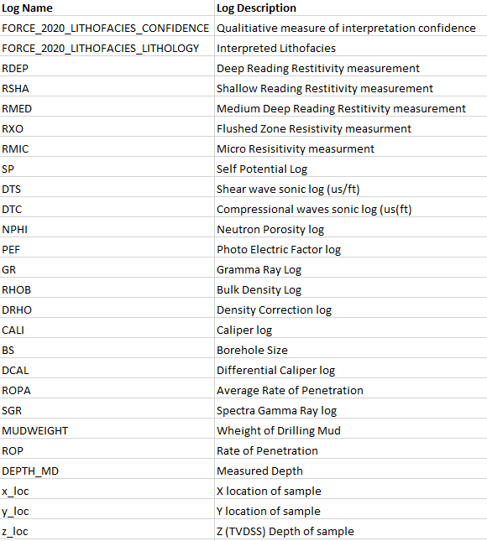
Description of the Dataset
Provided Dataset
The provided training dataset contains well logs, interpreted lithofacies and lithostratigraphy for 98 released wells from offshore Norway.
There are 10 wells in closed test dataset which are used for final scoring.
Many logs are missing, only DEPTH_MD and GR have no NaN values.

Slide 4
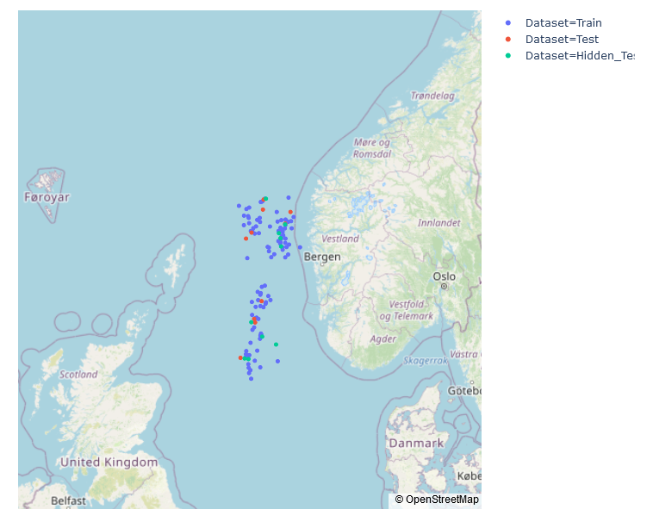
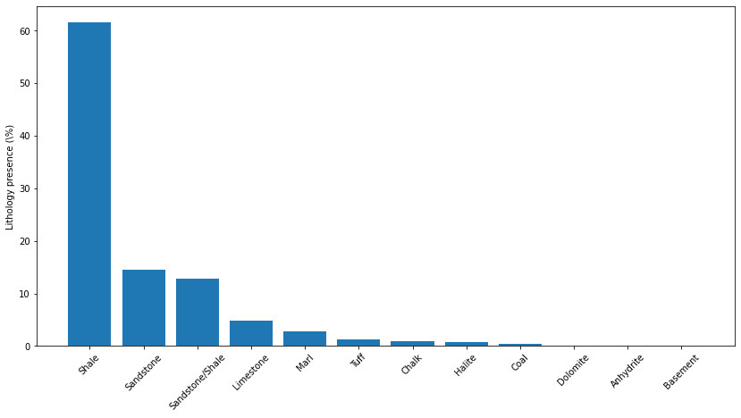
Description of the Dataset
Target Lithology Labels
1. Sandstone 2. Sandstone/Shale 3. Shale
4. Marl 5. Dolomite 6. Limestone
7. Chalk 8. Halite 9. Anhydrite
10. Tuff 11. Coal 12. Basement
Location of Wells based on the lat and long data from NPD Factpages
Target Label Distribution

Slide 5
Broader Strategy
Clustering Based on Spatial Location
Missing Data Flags
Interpolated Zone Flags
Despiking most of the logs
Flagging Bad Holes
Train and fill the flagged zones
Outlier Analysis
Feature Engineering
Dimensionality Reduction
Final Lithology Classification

Slide 6
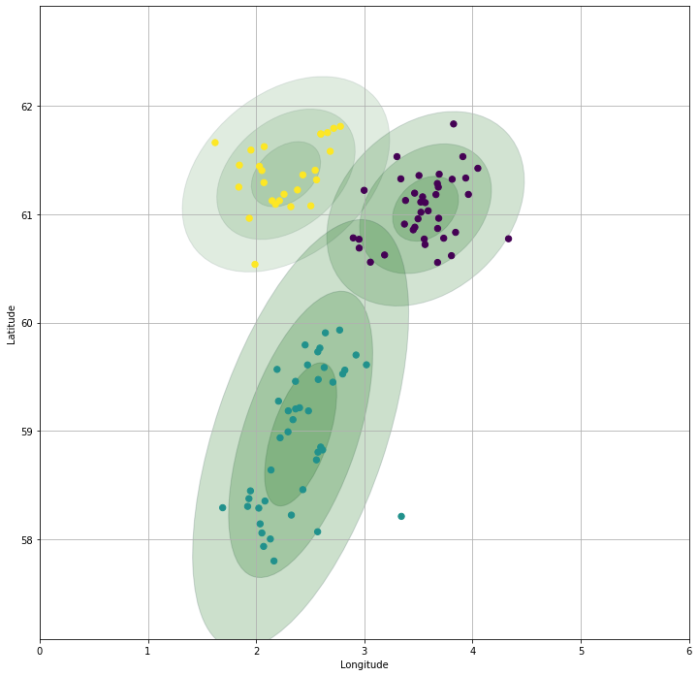
Clustering Based on Spatial Location
Wells that are closer together might have properties that are more correlated with each other, and this could be a useful fact to exploit when building machine learning models to predict log curves and lithofacies.
There are three clusters of points in the contest data. Two northern clusters and an elongated one to the south. Each cluster has at least a couple of test wells and hidden test wells. A clustering algorithm, Gaussian Mixture Models is used to assign a spatial cluster ID that might be a useful feature for machine learning.
Features added
Plot_size
Cluster1_prob
Cluster2_prob
Cluster3_prob

Slide 7
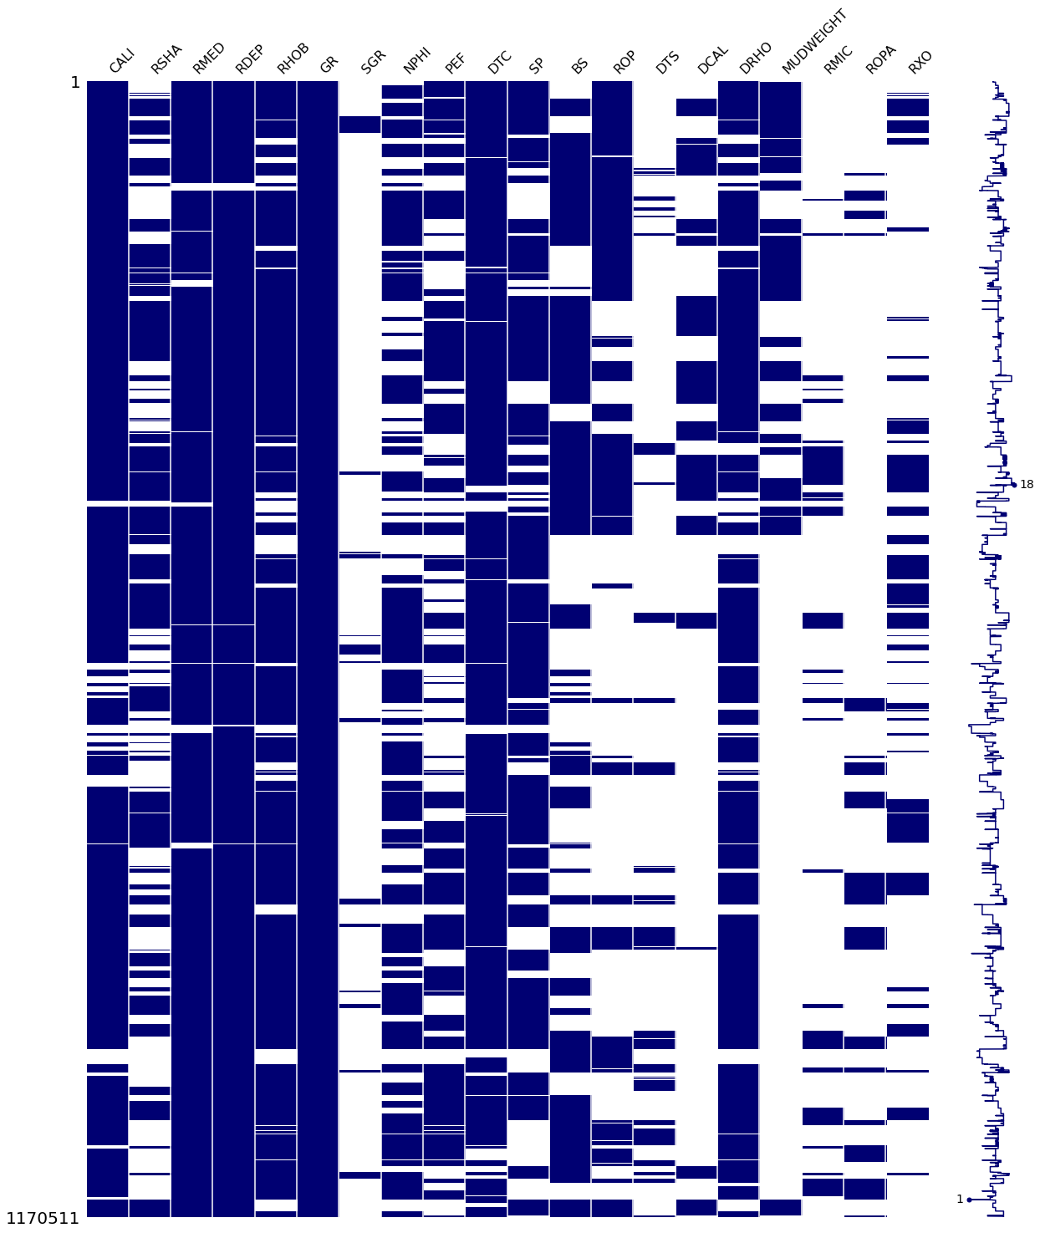
Missing Data Flag
Visual summary plot of the dataset completion, log by log (all wells together)

Slide 8
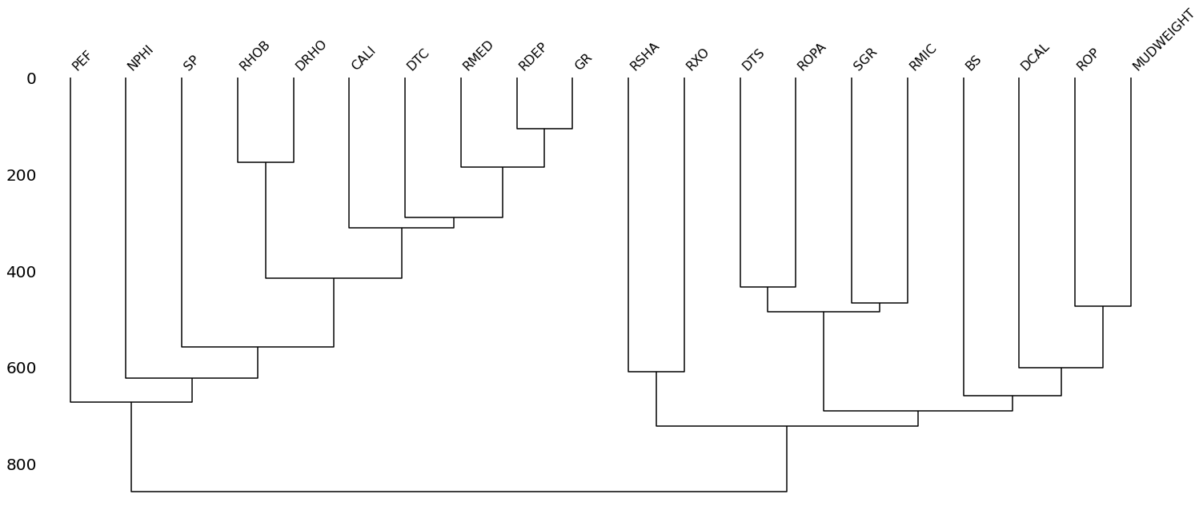
Missing Data Flag
To explore in more depth for the data completion, I have used a missingno 's dendrogram plot.
Interpreting the dendrogram in a top-down fashion, I will predict missing values in a sequential fashion rather than for all logs at once. For example, looking at the largest cluster on the left, and starting from top right, I have used GR to first predict missing values in RDEP, then both to predict missing values in RMED, then DTC. Then add CALI and used all logs completed so far to predict RHOB, and so on.

Slide 9
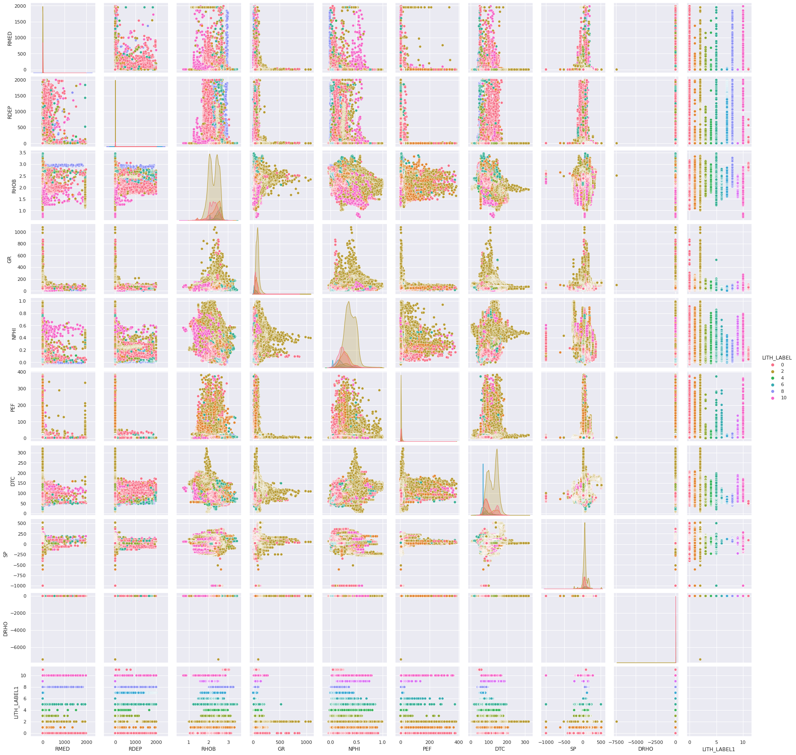
Interpolated Zone Flags
To identify erroneous data that have exact same log value which occurs many times below each other (interpolated data).
Continuous dots with a specific trend in the cross plot (log features with lithology) indicates that data is interpolated and the logs which show this trend are treated to find real values by finding their gradient.

Slide 10
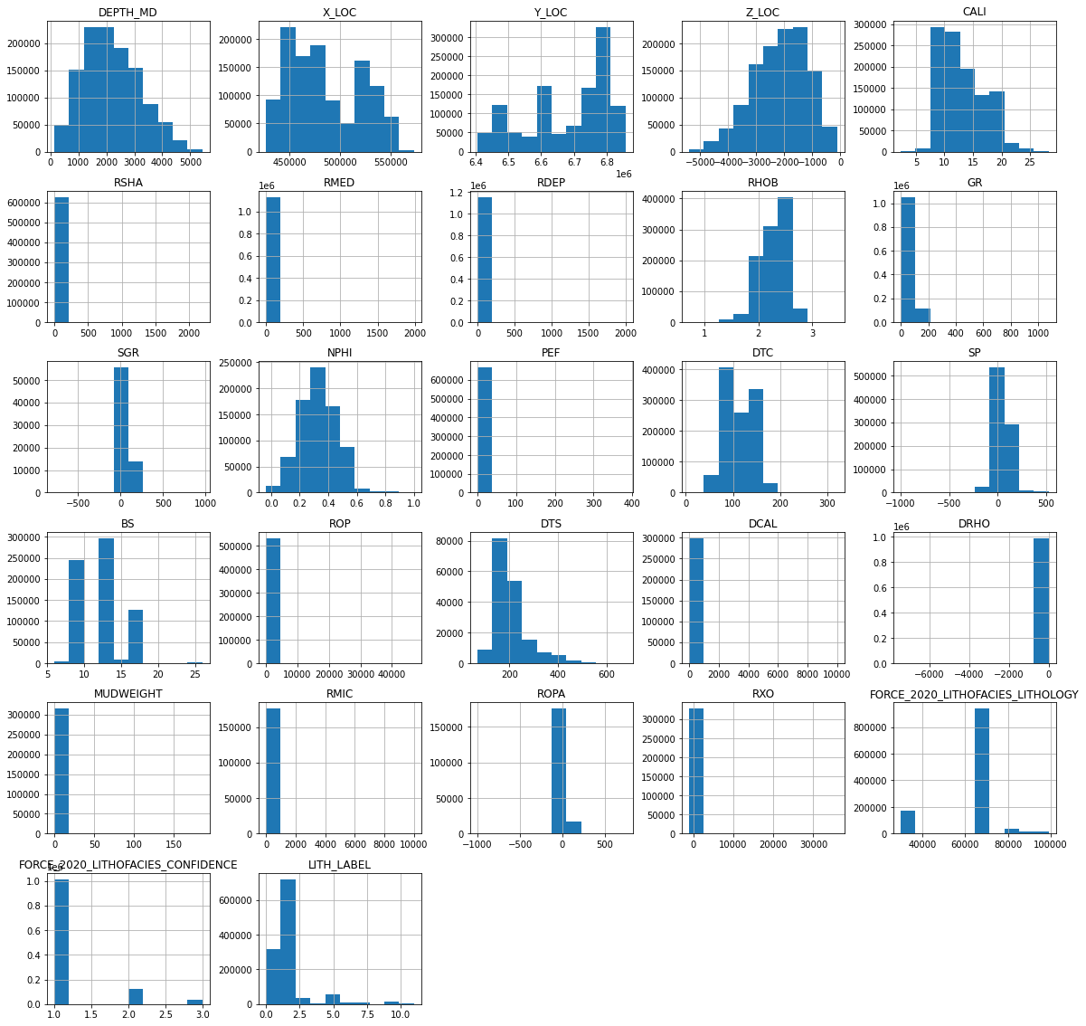
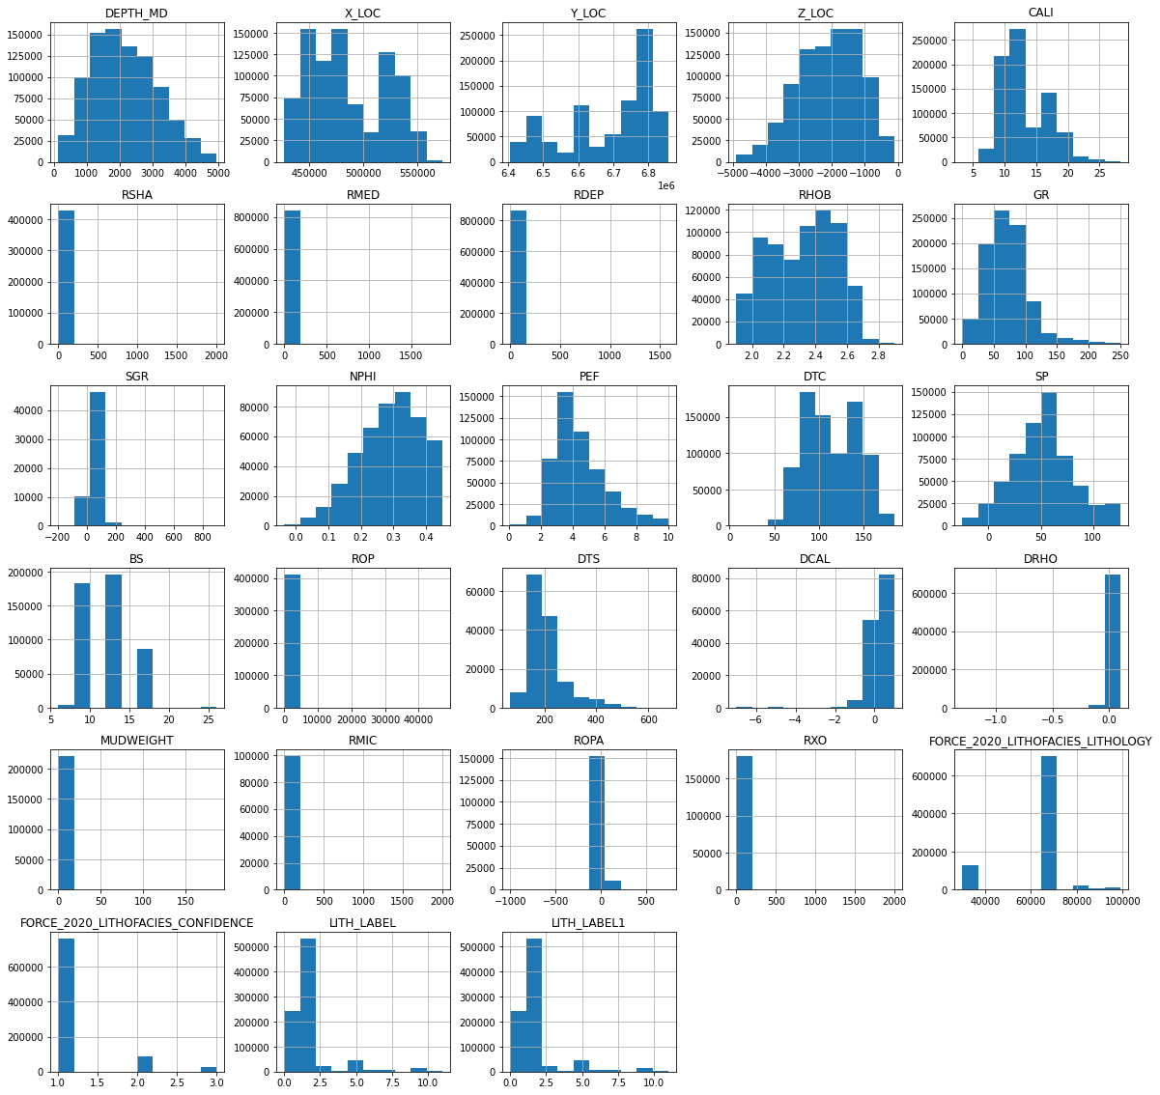
Despiking most of the logs
To remove the values which are outside physical bounds (spikes, recorded errors).
Before After

Slide 11
Despiking most of the logs
Log | Method | Reason
GR | X['GR'][X['GR']>250] = 250 X['GR'][X['GR']<8] = 8 | As from literature, except for Sylvite, all the lithologies have Gamma Ray Values in between 8-250.
NPHI | X['NPHI'][X['NPHI']>0.60]=np.nan X['NPHI'][X['NPHI']<0]=np.nan | From describe function, range of NPHI log is identified between 0 and 0.60
RHOB | X['RHOB'][X['RHOB']<1.9]=np.nan X['RHOB'][X['RHOB']>2.9]=np.nan | It is known from literature that RHOB lies between 1.9 and 2.9
PEF | X = X.drop(X[X['PEF']>10].index) | From literature 0-10
SP | X = X.drop(X[X['SP']>126].index) X = X.drop(X[X['SP']<-25].index) | based on test data
DTC | X = X.drop(X[X['DTC']>184].index) | based on test data
DRHO | X = X.drop(X[X['DRHO']>0.1].index) X = X.drop(X[X['DRHO']<-1.3].index) #based on test data | From Literature : DRHO values in excess of 0.1 g/cm3 indicate unreliable density data
RMED RDEP | X = X.drop(X[X['RMED']>1902].index) #from test data X = X.drop(X[X['RDEP']>1583].index) #from test data X = X.drop(X[X['RMED']<0].index) #from literature X = X.drop(X[X['RDEP']<0].index) #from literature | From Literature : Resistivity Logs Range (0 – 2000). In certain bedded zones where, resistivity logs show spikes (such as resistivity in coal), that spikes will not be removed.

Slide 12
Log | Method | Reason
RMIC RXO RSHA | X['RMIC'][X['RMIC']>2000] = np.nan X['RXO'][X['RXO']>2000] = np.nan X['RSHA'][X['RSHA']>2000] = np.nan X['RXO'][X['RXO']<0] = np.nan X['RSHA'][X['RSHA']<0] = np.nan | From Literature : Resistivity Logs Range (0 – 2000).
DCAL | X = X.drop(X[X['DCAL']>1].index) X = X.drop(X[X['DCAL']<-7].index) #from test data | From literature (considered breakout above 1)

Slide 13
Flagging Bad Holes
I have already flagged the zones on the basis of DCAL and DRHO. Other methods which I have used:-
Using Caliper log, Borehole Size (BS) to identify rugosity and washout and flag bad hole
X = X.drop(X[X['CALI']<0.98*X['BS']].index) #for rugosity
X = X.drop(X[X['CALI']>1.02*X['BS']].index) #for breakout
Using ensemble model for DTC and compare the predicted DTC with actual log values to flag bad hole. (If the difference between predicted and actual is large, that zone will be flagged)
I have used GR, Depth, Spatial Features and Lithostratigraphy features to first predict missing values for RDEP, then added that to above features to predict missing values in RMED and then DTC. If the difference between predicted and actual is large, that zone will be flagged and will be replaced with the predicted DTC.

Slide 14
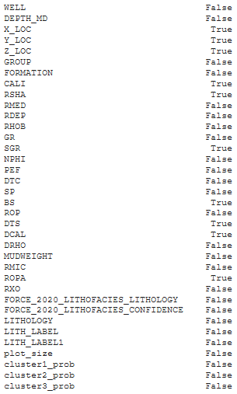
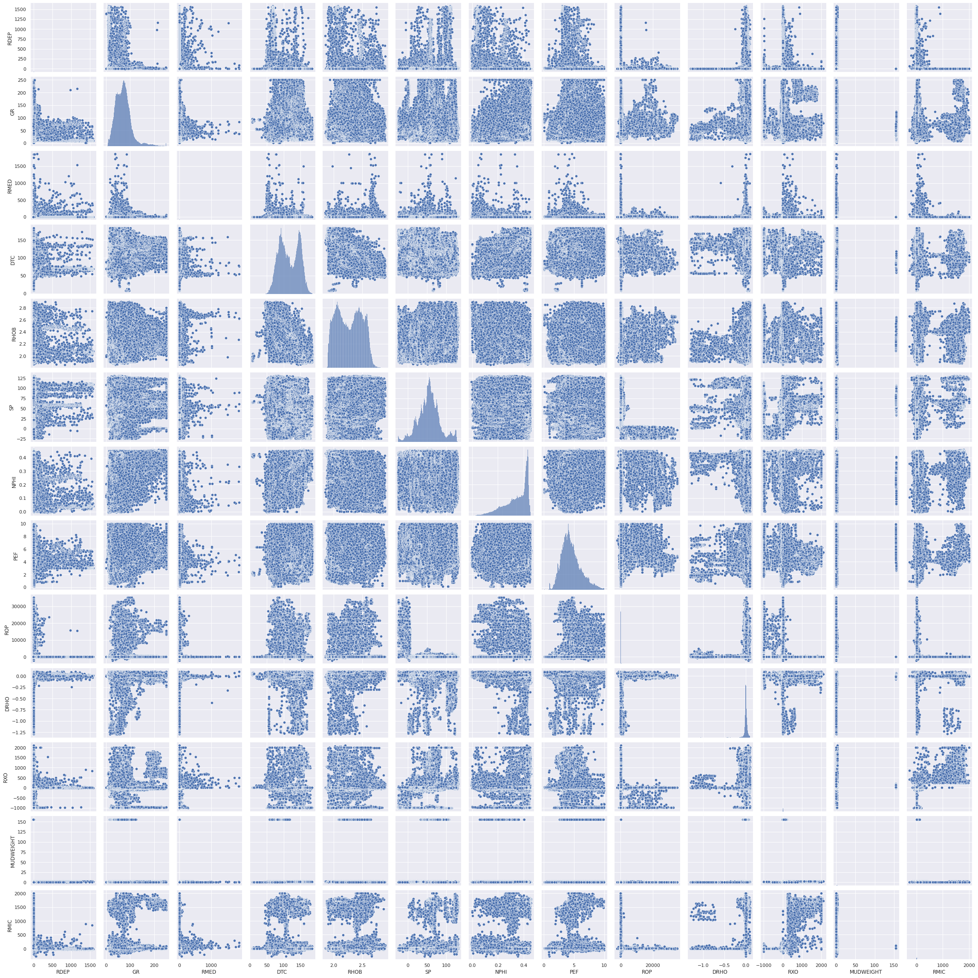
Train and fill the above-flagged zones (using Regression Models)
I have already created model for DTC, now this feature will be added to the existing features to predict RHOB and similarly SP, NPHI, PEF, ROP, DRHO, RXO, MUDWEIGHT and RMIC in this sequence. Remaining petrophysical log features are removed.

Slide 15
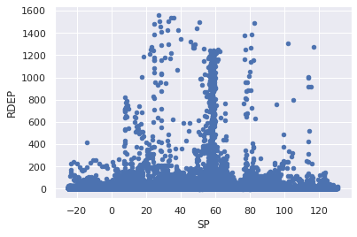
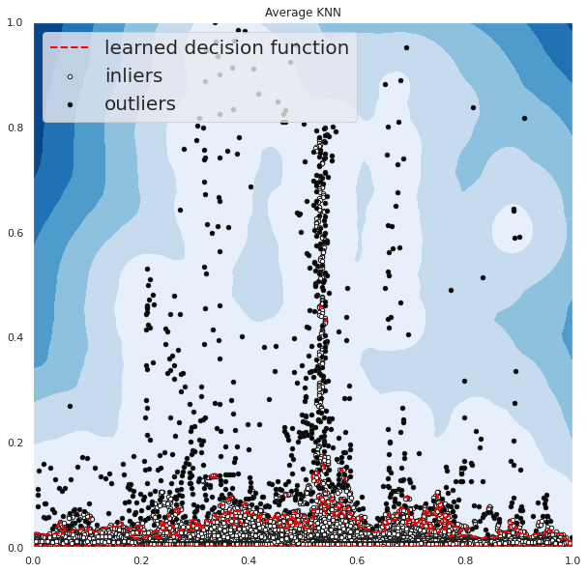
Outlier Analysis
Unsupervised Outlier detection to find Collective outliers which are a small cluster of data that as a whole deviate significantly from the entire dataset, for example, log measurements from regions affected by borehole washout. Isolation Forest and Average KNN is used for identifying inliers and outliers. (BS and CALI logs missing for many wells).

Slide 16
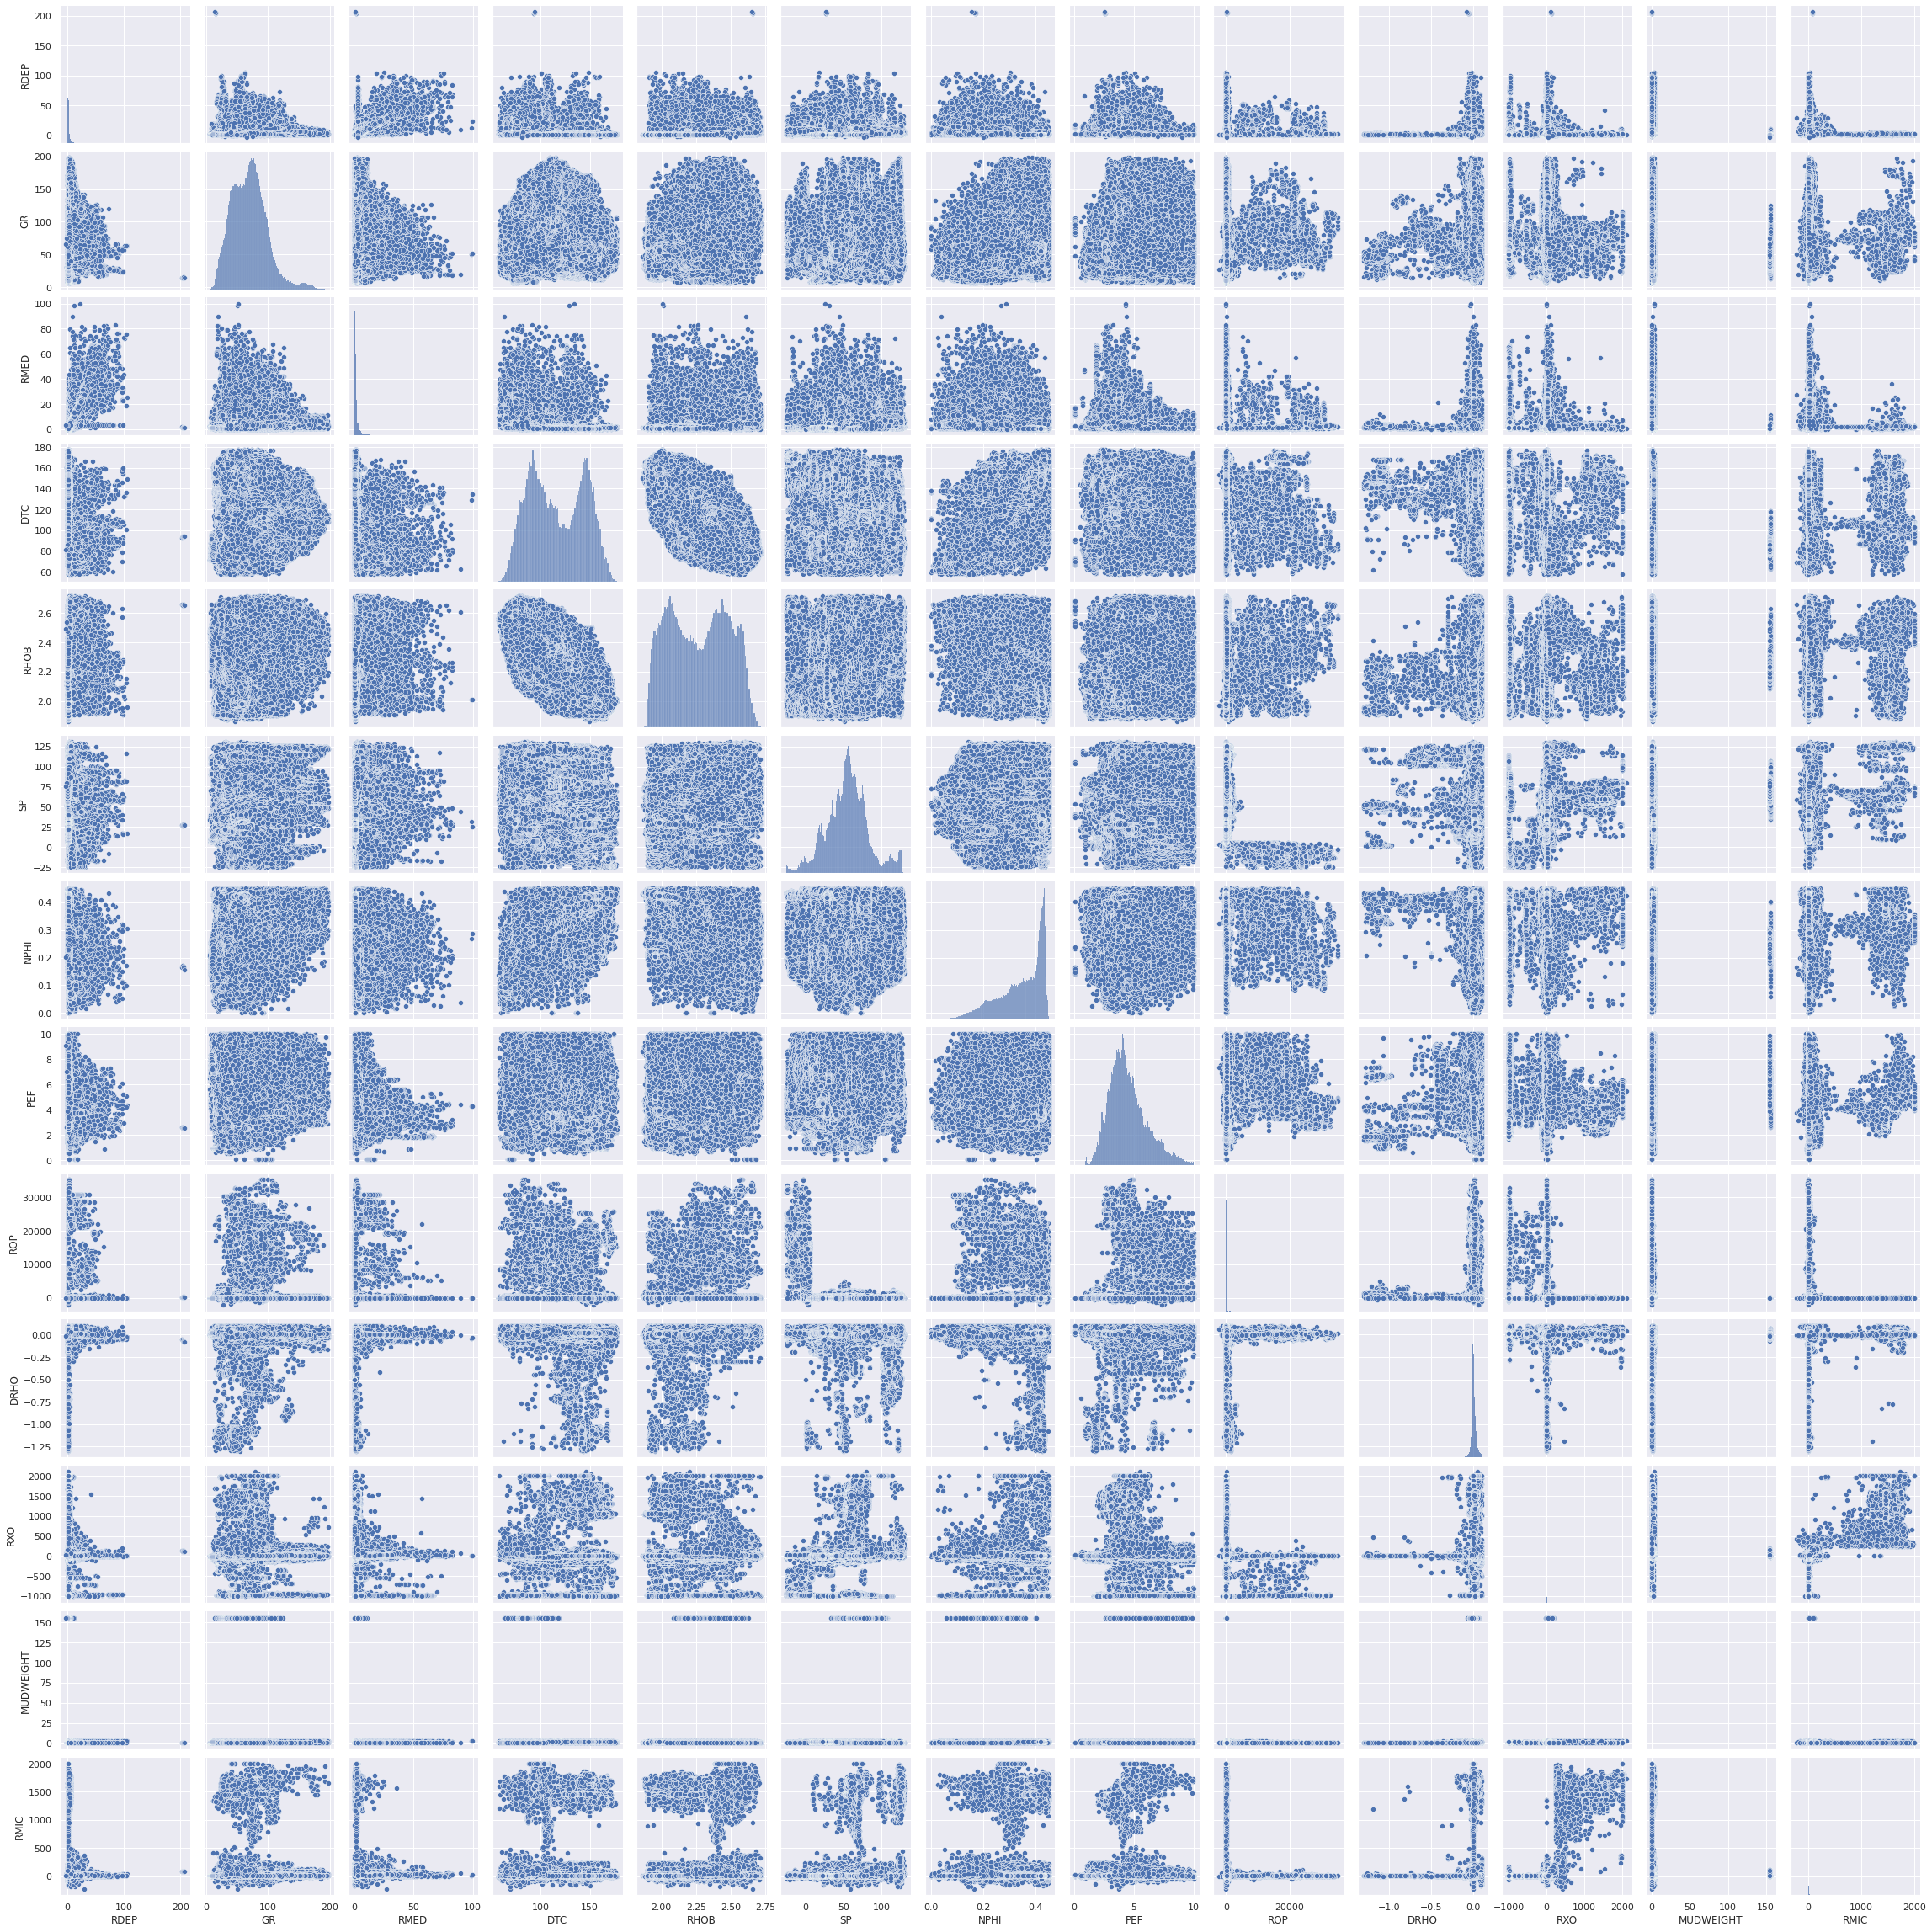

After Removing Outliers

Slide 17
Feature Engineering
Creating new features by taking gradient of processed petrophysical logs. (to address interpolation).
Logarithmic transformation for resistivity logs to avoid large weight on resistivity logs.
To remove the noise, preserve the relative magnitude of the signals, we use median filter to preprocess input features.
Adding Shale Volume using GR log
X['IGR'] = (X['GR'] - min(X['GR']))/(max(X['GR'] - min(X['GR'])))
X['Vsh'] = X['IGR']/(3 - 2*X['IGR’])
Adding Carbon Index using RHOB log
X['Carbon_Index'] = ((154.497/X.RHOB.values) - 57.261)

Slide 18
Dimensionality Reduction
Removed Features with high collinearity.
Removed Feature based on p-value.
Removed Features based on mutual information.
Removed Features with low variance.
Columns in Final Dataset (After Dimensionality Reduction)
DEPTH_MD, RMED, RHOB, GR, NPHI, PEF, DTC , SP, ROP, DRHO, RXO, MUDWEIGHT, RDEPgrad, GRgrad, DTCgrad, SPgrad, RXOgrad, RMICgrad, RMED_log, Carbon_Index, plot_size, cluster1_prob, cluster2_prob, cluster3_prob, WELL, GROUP, FORMATION, FORCE_2020_LITHOFACIES_CONFIDENCE, LITHOLOGY

Slide 19
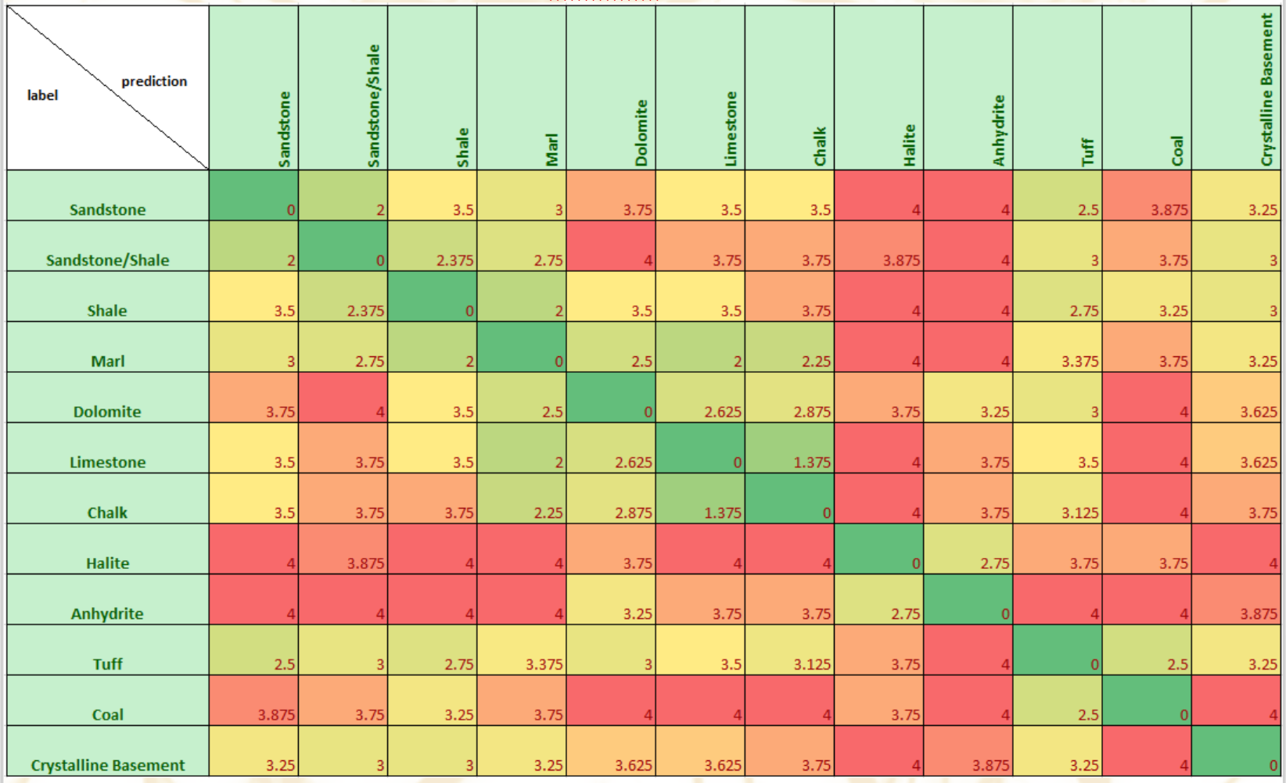
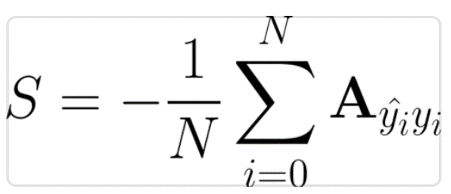
Scoring Function
We have been provided a custom made penalty matrix derived from the averaged input of a representative sample of geoscientists. This allows for petrophysically unreasonable predictions to be scored by a degree of “wrongness”.
where A is the scoring matrix above, N is the number of samples, ŷ_i is the true lithology label and y_i is the predicted lithology label

Slide 20
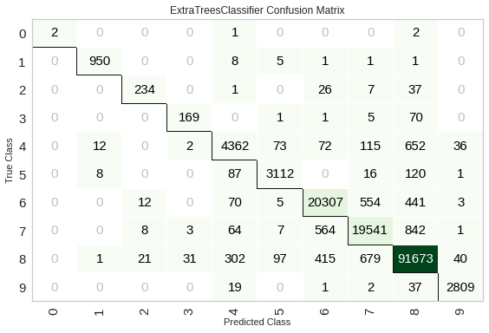
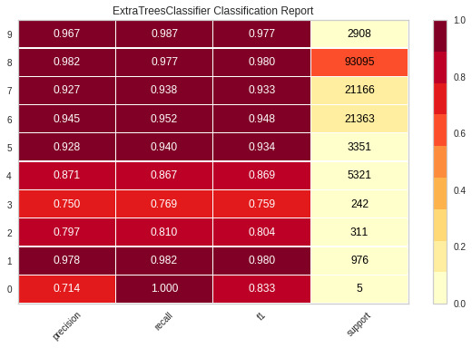
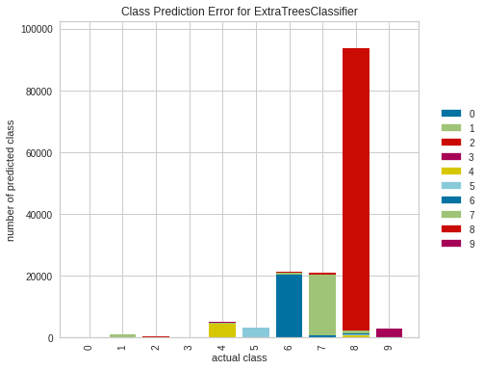
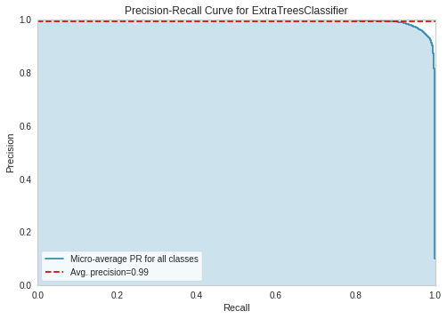
Final Lithology Classification
Model
ExtraTree Regressor
Stratified train-test
Normalization : z score
Class_Weight : balanced
Number of K-folds : 40

Slide 21
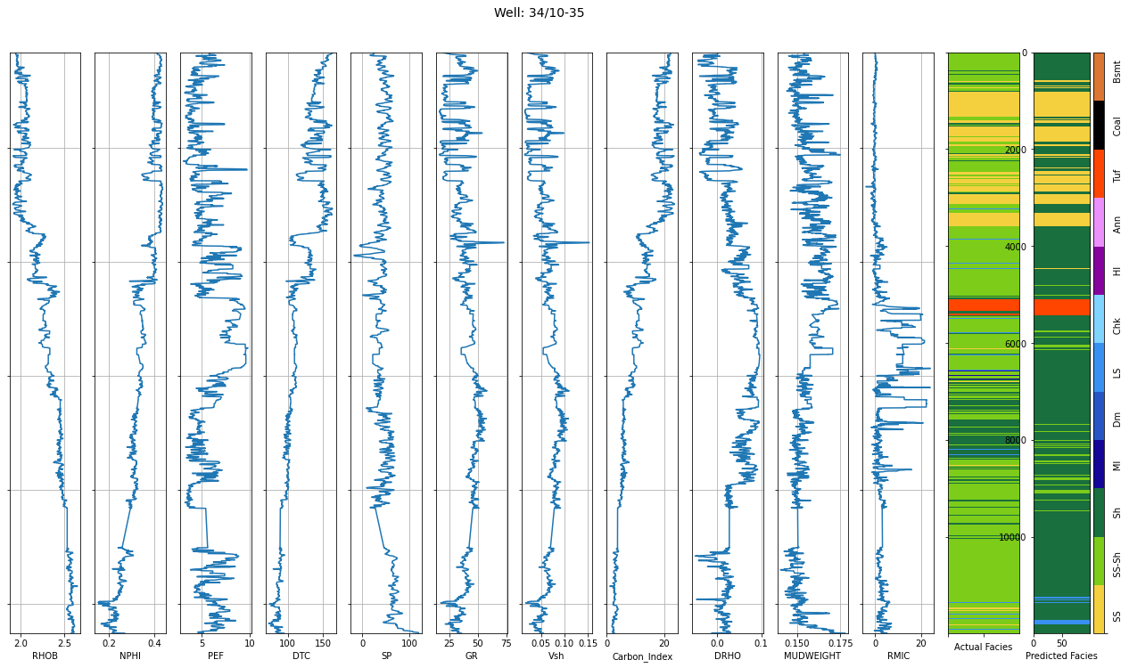
Classification Result
Test Wells: - '30/3-3','30/6-5','31/2-9','15/9-13','16/10-1','33/9-1','34/10-35
Error using Scoring Function:- -0.712

Slide 22
Towards a global model
Now we have identified a workflow for facies classification. So, irrespective of the region from which dataset is coming, following steps will remain same and the strategy will be same:-
Clustering Based on Spatial Location (if location data is available)
Despiking logs
Flagging Bad Holes
Train and fill the flagged zones
Outlier Analysis
Feature Engineering
Dimensionality Reduction
Final Lithology Classification
We can automate the whole process by using tools like Spotfire/PowerBi where we can visualize results at each step and analyse the output at each step. We will have multiple options (which have been already identified for this problem) for each step and by the process of hit and trial, for each dataset best strategy can be determined. For now, for final classification, we can use models which have been identified to perform well such as Random Forest, Extra Tree Regressor and Decision Tree and also tune them from the dashboard. This will allow us to understand how the model is picking up on signal and improve model performance.

Slide 23
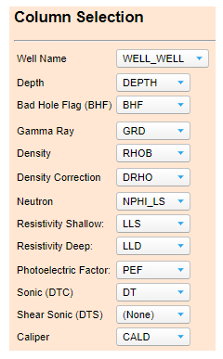
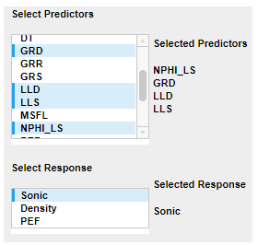
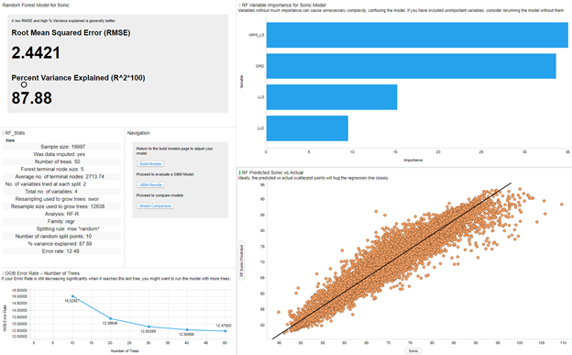
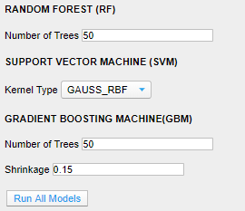
Towards a global model
One other way to identify the classification model, with no prior feature engineering, We can try each of the machine learning model on a limited number of wells (around 10) with 2 wells in the holdout dataset to identify the best model.

Slide 24
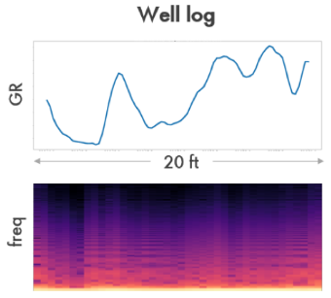
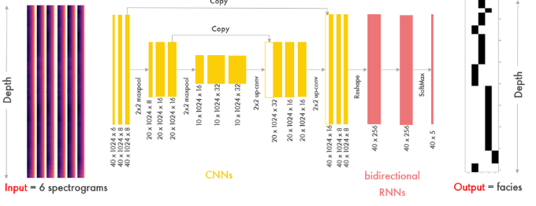
More things in pipeline
Trying Neural Networks
We can convert each 10 ft section of each geophysical properties from well logs to log-spectrograms using Short Time Fourier Transform (STFT) with 5 ft of overlap in order to cover as many facies sequences as possible. The texture-like spectrogram contains distinctive patterns that capture different characteristics of facies as well as the transition between two facies, which becomes discrete. Facies classification with convolutional and bidirectional networks.
https://www.researchgate.net/publication/337403122_FaciesNet_Machine_Learning_Applications_for_Facies_Classification_in_Well_Logs

